Slide 1
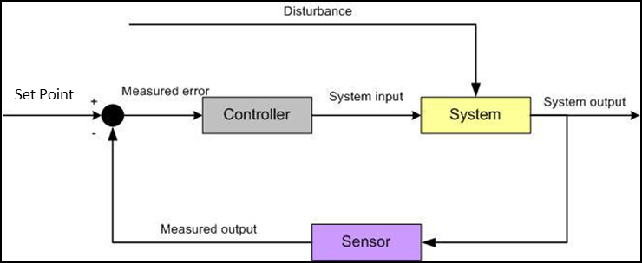
Proportional Integral Differential (PID)
Most common type of controller
e.g. Cruise Control
Set Point – desired value of output
Error – difference between set point and current output (process variable)
PID - is a control loop feedback mechanism widely used in a variety of applications requiring continuously modulated control. A PID controller continuously calculates an error value e (t) as the difference between a desired set point (SP) and a measured process variable (PV) and applies a correction based on proportional, integral and differential error terms.
1

Slide 2
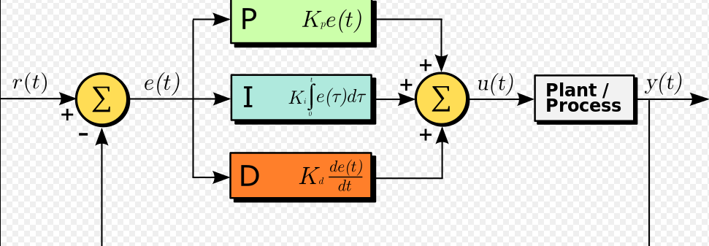
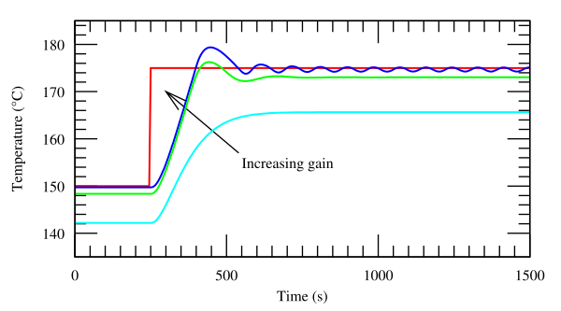
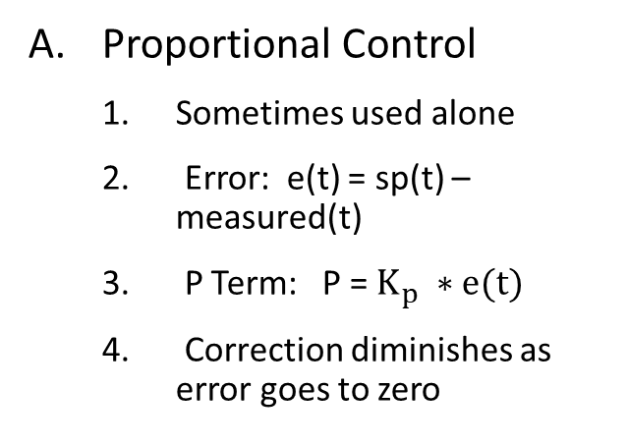
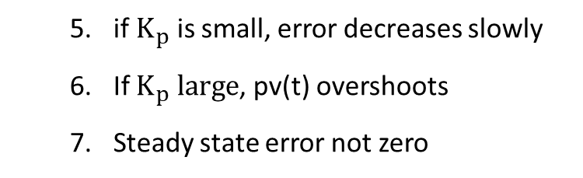
Proportional Control
Sometimes used alone
Error: e(t) = sp(t) – measured(t)
P Term: P = $K_{p} ∗e(t)$
Correction diminishes as error goes to zero
if $K_{p}$ is small, error decreases slowly
If $K_{p} large$, pv(t) overshoots
Steady state error not zero
1

Slide 3
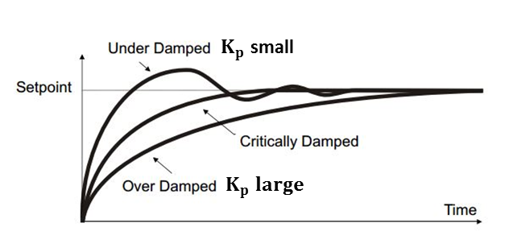
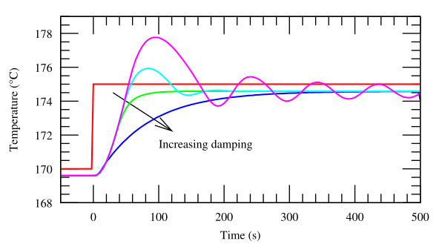
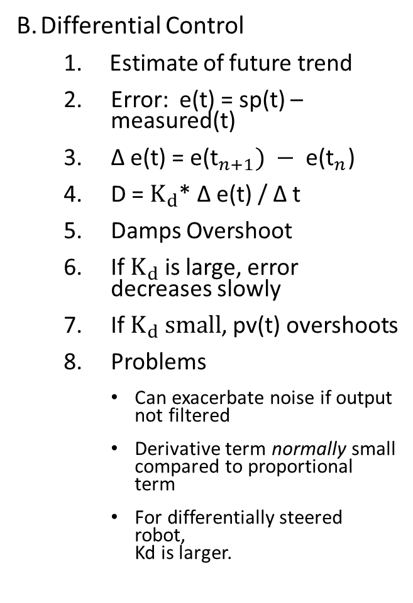
Differential Control
Estimate of future trend
Error: e(t) = sp(t) – measured(t)
Δ e(t) = ${\text{e}\text{(}\text{t}}_{n+1}) − {\text{e}\text{(}\text{t}}_{n}$)
D = $K_{d}$* Δ e(t) / Δ t
Damps Overshoot
If $K_{d}$ is large, error decreases slowly
If $K_{d} small$, pv(t) overshoots
Problems
Can exacerbate noise if output not filtered
Derivative term normally small compared to proportional term
For differentially steered robot, Kd is larger.
1

Slide 4
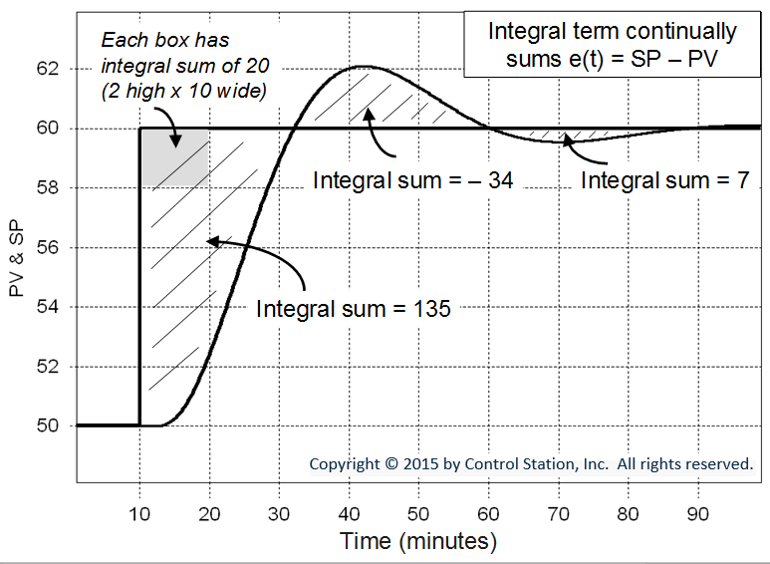

Integral Control
I corrects residual offset errors
PI controller, e.g. for line following
Error: e(t) = sp(t) – measure(t)
I = I + $K_{i} \text{∗}$ e(t) * Δt
Problem of Integral Windup
If ramping up set point
Disable until in controllable region
Set bounds
Reset for new set point
Integral Windup - refers to the situation in a PID controller where a large change in set point occurs and the integral term accumulates a significant error during the change, thus overshooting and continuing to increase as the accumulated error is offset by errors in the other direction.
2

Slide 5
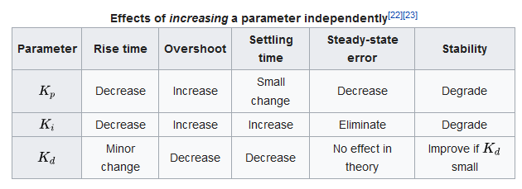
Tuning
Setting PID coefficients somewhat of an art
Trial and error; tuning formulas; auto tuners
Start with P, add I, add D last
PID has many refinements

